Slide 1
Xpress Tech Delivery
Supply Chain Analysis

Slide 2
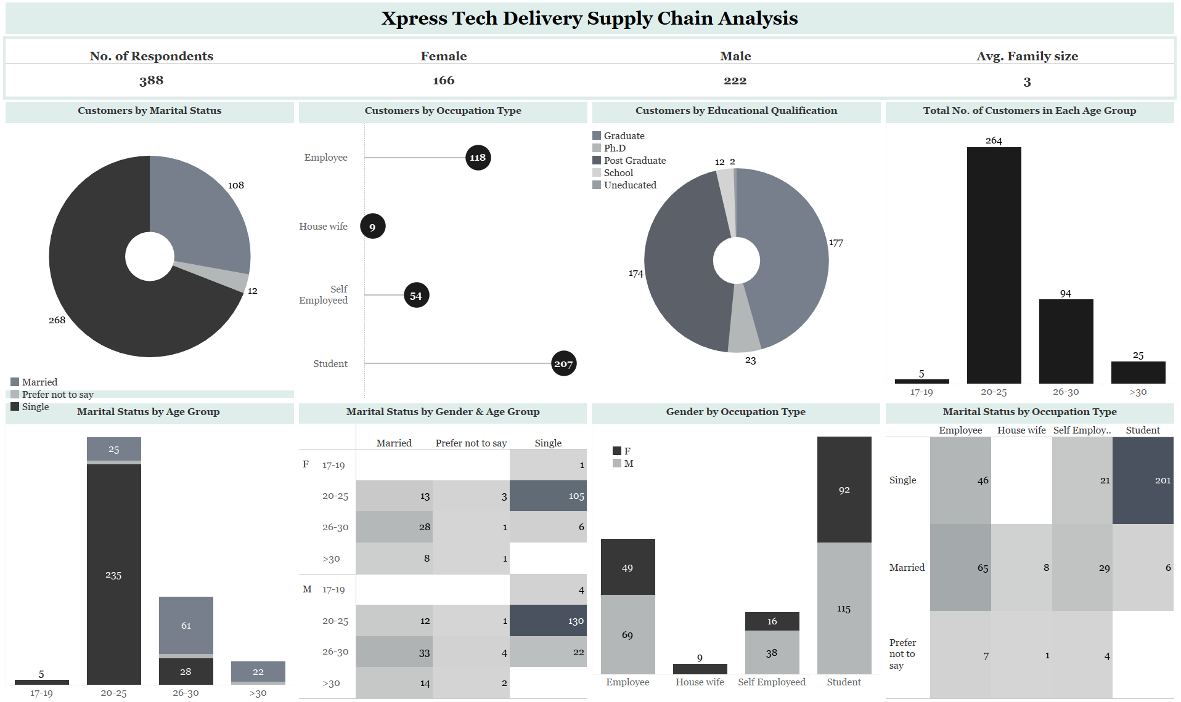

Slide 3
Insights
The total number of respondents that answered the survey is 388;
The average family size of the respondents is 3;
The majority of the survey respondents are male with a total number of 222;
The uneducated group makes up the least number of customers patronizing the company with a total number of two customers whereas those with higher qualifications make up the highest proportion;
Customers in the age group 20-25 make up 68% of the entire respondents followed by customers in the age group 26-30;
The male customers surpass the female customers in every category except the housewife and the marital status of Married and "prefer not to say" in the age group 20-25;
The single customers make up the highest proportion of the customers;
More than 85% of the single customers belong to the 20-25 age group;
The single students are the highest patronizers of the company;
Out of the 108 married people who patronize the company, the majority of people in this category are employees of various organizations and they make up 60% of the total figure of that marital group.
Recommendations
From the insights generated, it is obvious that the younger, single customers between the ages of 20-30 make up the highest number of customers. As such, aggressive marketing campaigns should be directed toward these groups of people;
The male customers have been seen to be more inclined to purchase food compared to the female customers regardless of their marital status or occupation type so more promotional campaigns should also be directed towards them;
Promotional discounts should be given to students with valid student IDs to encourage more patronage;
More marketing campaigns should be directed toward married and working-class women to encourage them to patronize more and save them from the time and stress associated with cooking.

Slide 4
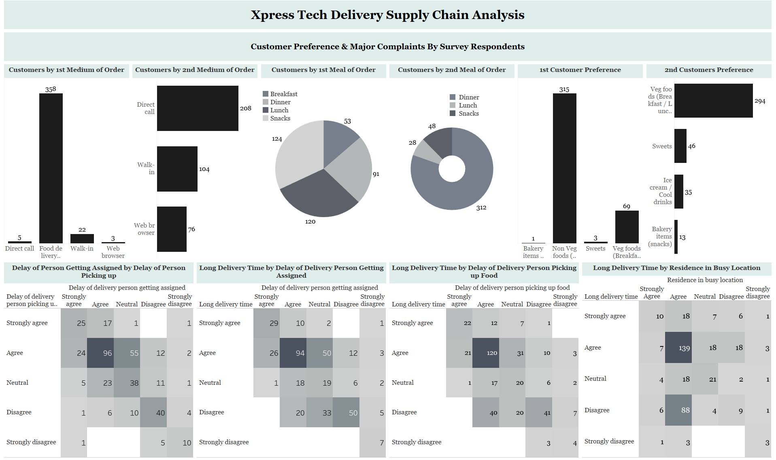

Slide 5
Insights And Recommendations
Insights:
The majority of the customers prefer to order via the food delivery app followed by the direct call method and then the walk-in method;
A total of 284 i.e 73% of the customers, including those in the neutral category agree that it takes a while for the delivery persons to get assigned to their orders and to pick up the orders;
A total of 249 i.e 64% of the customers, including those in the neutral category agree that the delivery takes too long due to delay of a delivery person getting assigned;
A total of 251 i.e 64% of the customers, including those in the neutral category agree that the delivery takes too long due to delay of a delivery person picking up the food;
Recommendation:
More delivery persons should be employed and more training should be given to the delivery persons to help reduce the delivery time and improve customer satisfaction.

Slide 6
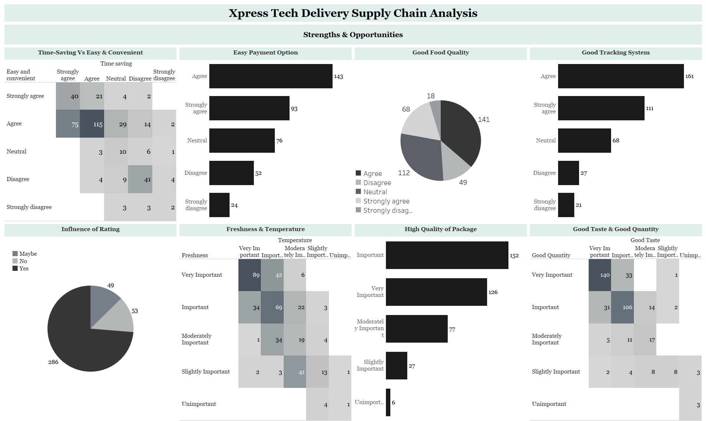

Slide 7
Insights And Recommendations
Insights:
297 i.e. 76% of the customers, including those in the neutral category agree that the order service is easy, convenient, and time-saving;
82% of the customers agree that the company provides good food quality;
The majority of the customers agree that the company has a good tracking system and easy payment options;
Majority of the customers are influenced to purchase from the company through the rating;
234 customers consider the freshness and temperature of the food to be important;
310 customers consider it important for the food to have good taste and good quantity.
Recommendation:
It is important to take note of these strengths and opportunities and build on them to improve customer satisfaction and possibly increase the number of patronages.

